Slide 1

Cosmetic Insight Navigating Cosmetic Trends and Consumer Insights with Tableau
Prepared by : Rajesh Manku
Internship :Data Analytics With Tableau
Team ID : LTVIP2025TMID47653
Email ID : mankurajesh666@gmail.com

Slide 2

INTRODUCTION :
Hello everyone, my name is Rajesh Manku. Today, I’m excited to present my project titled Cosmetic Insights: Navigating Cosmetic Trends and Consumer Insights with Tableau.
The main objective of this project is to analyze cosmetic product data from various brands, focusing on aspects like brand performance, product suitability for different skin types, price ranges, and label preferences.
By visualizing this data through interactive Tableau dashboards, the goal is to uncover insights into which brands have the highest presence in the market, how different labels are performing, which products are suitable for various skin types, and how prices are distributed across brands.
These insights will help in understanding consumer preferences, brand competitiveness, and market trends, which can be valuable for product strategy, marketing decisions, and customer targeting.

Slide 3

Dashboard 1: Product Ranking and Detailed Analysis
This dashboard provides a comprehensive view of cosmetic product distribution, pricing, and brand performance.
Label Count: A bar chart showing the number of products available under different product labels like Moisturizer, Cleanser, Face Mask, Treatment, Eye Cream, and Sun Protection. 👉 Insight: Moisturizers and Cleansers are the most common product categories.
Top Brands (Pie Chart): A pie chart displaying the top brands by product count. 👉 Insight: Brands like Clinique, Murad, Origins, Sephora Collection, and Shiseido have a significant market share.
Price vs Brand (Box Plot): Shows the price distribution across different brands. 👉 Insight: Most product prices are clustered below ₹2000, but a few luxury brands have products priced much higher, exceeding ₹5000.
Brand vs Ranking (Bar Chart): Visualizes the number of records (products) at different ranking levels. 👉 Insight: Most products are ranked between 3.5 and 4.5, indicating generally favorable consumer reviews.

Slide 4
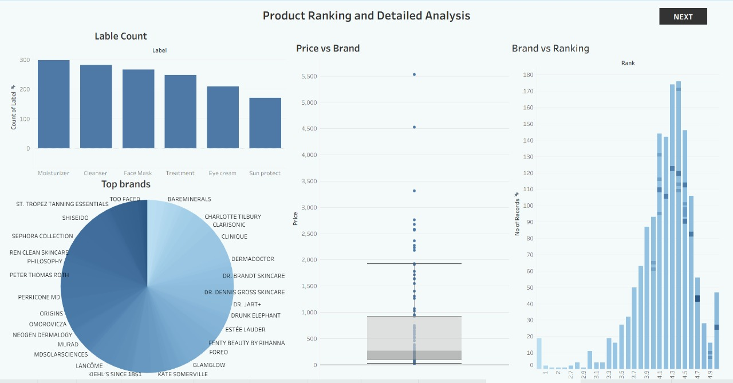

Slide 5
Dashboard 2: Product Suitability Overview
This dashboard focuses on analyzing product suitability for different skin types: Sensitive, Oily, Dry, and Normal skin.
Sensitive Skin Suitability (Bar Chart): Displays the number of products suitable and not suitable for sensitive skin by brand. 👉 Insight: Brands like Clinique, Sephora Collection, and Shiseido have more suitable products for sensitive skin.
Oily Skin Suitability (Bar Chart): Shows how many products from each brand are suitable for oily skin. 👉 Insight: A significant number of products across multiple brands are suitable for oily skin, with peaks in certain brands like Clinique, GlamGlow, and Fenty Beauty.
Normal Skin Suitability (Box Plot): Visualizes the distribution of product suitability for normal skin. 👉 Insight: Most products fall within a certain suitability range, with a fair balance between suitable and not suitable.
Dry Skin Suitability (Bubble Chart): Represents the number of suitable and not suitable products for dry skin using bubbles, where larger bubbles indicate higher counts. 👉 Insight: There’s a diverse range of product suitability for dry skin, with certain brands offering more dry-skin-friendly products.

Slide 6
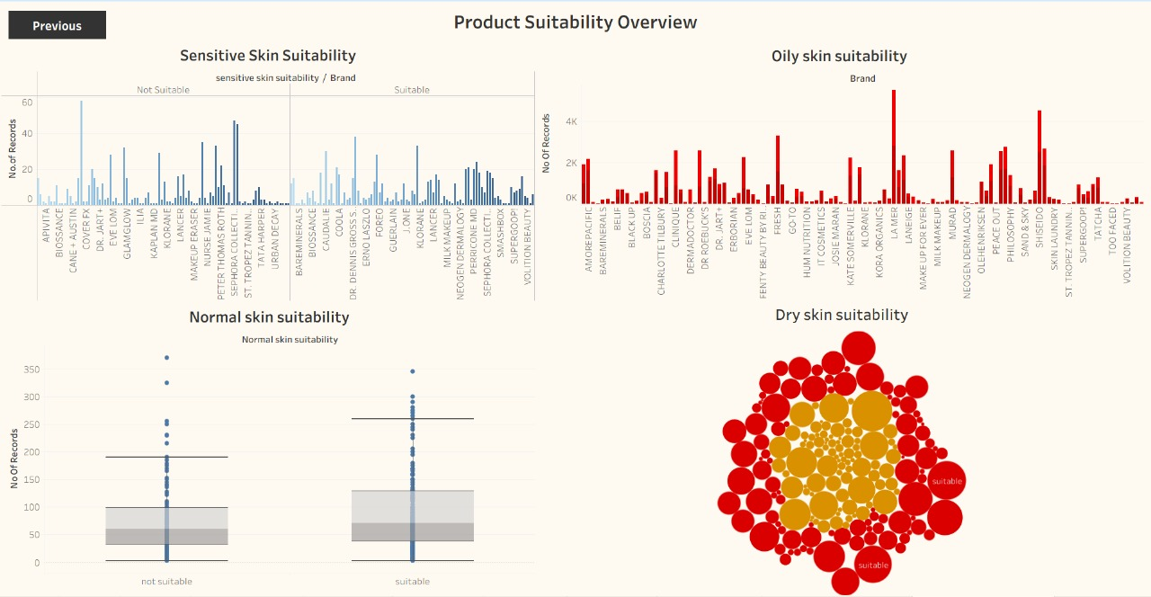

Slide 7
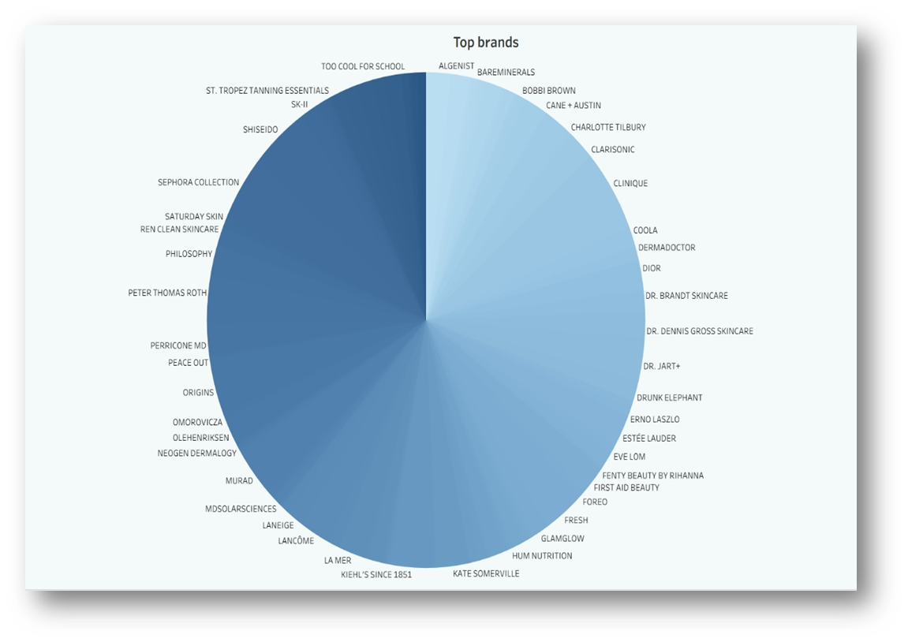
Top Brands
What it shows: A pie chart representing the distribution of product counts across the top cosmetic brands.
Insights:
Clinique has the highest number of products listed in the dataset.
Followed by Murad, Origins, Sephora Collection, and Shiseido.
Why it matters: Identifies which brands have the widest variety of products in the market, indicating their market presence and possible popularity among consumers.

Slide 8
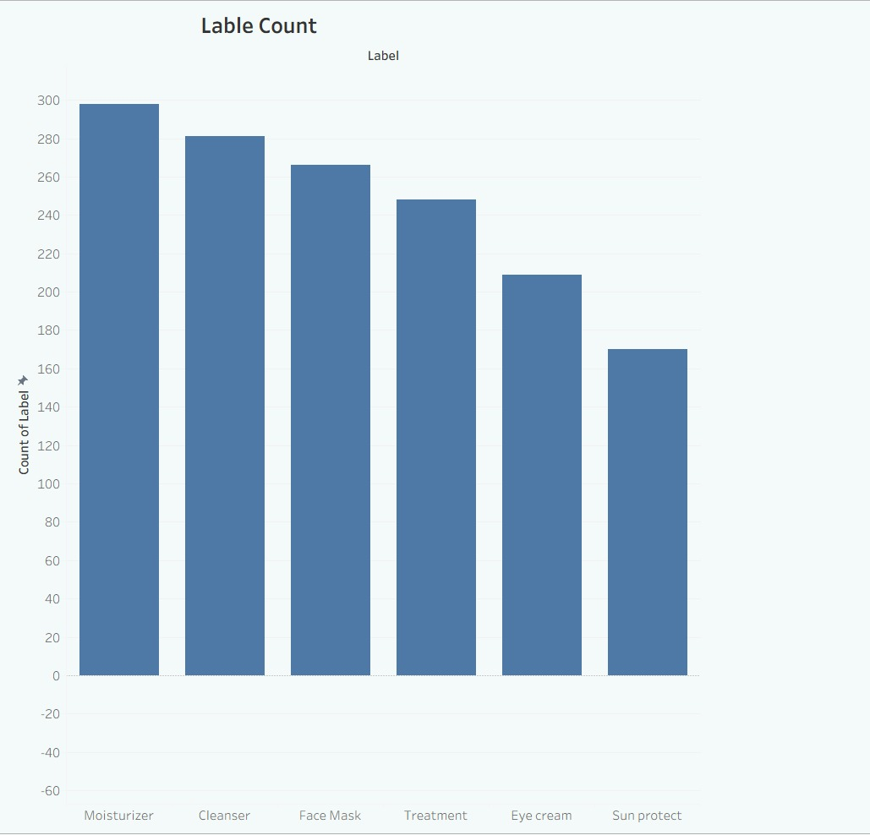
Label Count
What it shows: A bar chart displaying the count of different product labels such as Moisturizer, Cleanser, Face Mask, Treatment, etc.
Insights:
Moisturizer and Cleanser labels are the most common.
Sun protection and Eye Cream are among the least.
Why it matters: Helps understand the type of products dominating the market and the trends in consumer demand.

Slide 9
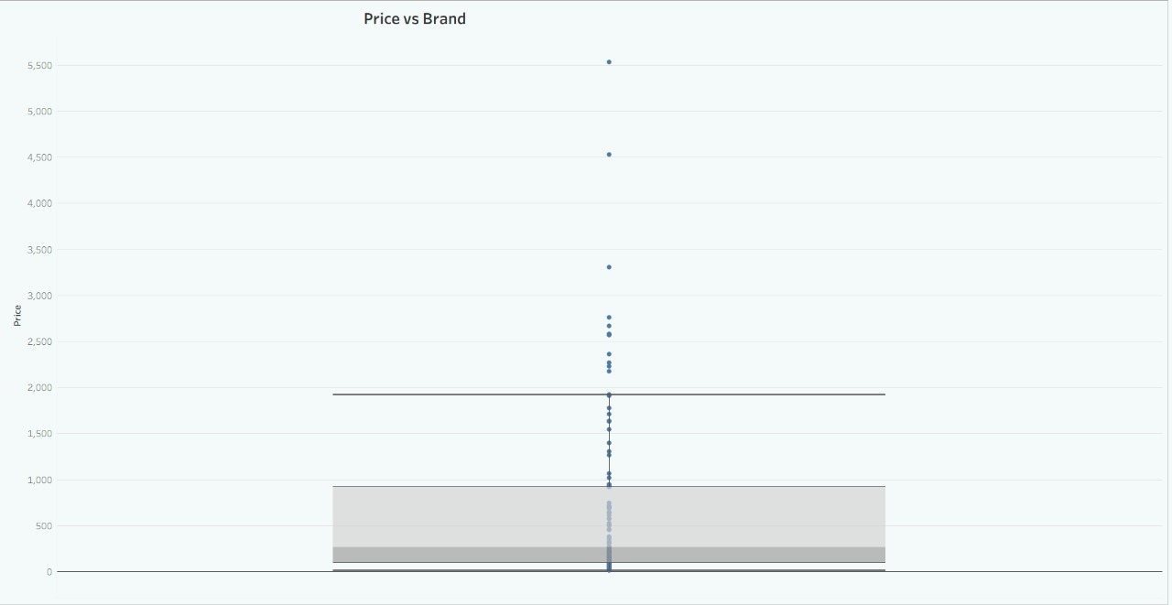
Price Vs Brand
What it shows: A box plot visualizing the price distribution of products for each brand.
Insights:
Majority of product prices are below ₹2000.
Some luxury brands have products priced as high as ₹5000 and above.
Why it matters: Gives an overview of how brands position themselves — whether as affordable, mid-range, or premium.

Slide 10
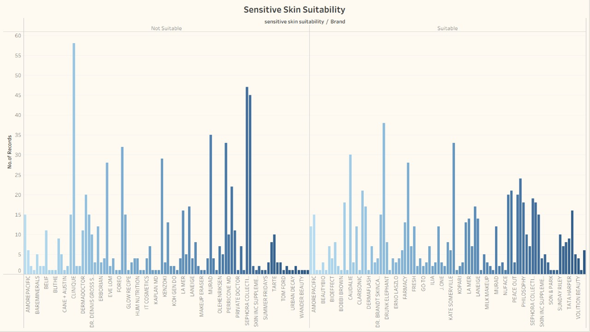
Sensitive Skin Suitability
What it shows: A bar chart showing the number of products suitable and not suitable for sensitive skin, categorized by brand.
Insights:
Some brands like Clinique, Sephora Collection offer more suitable products for sensitive skin.
Why it matters: Helps consumers with sensitive skin identify safer product options and guides brands on which areas need improvement.

Slide 11
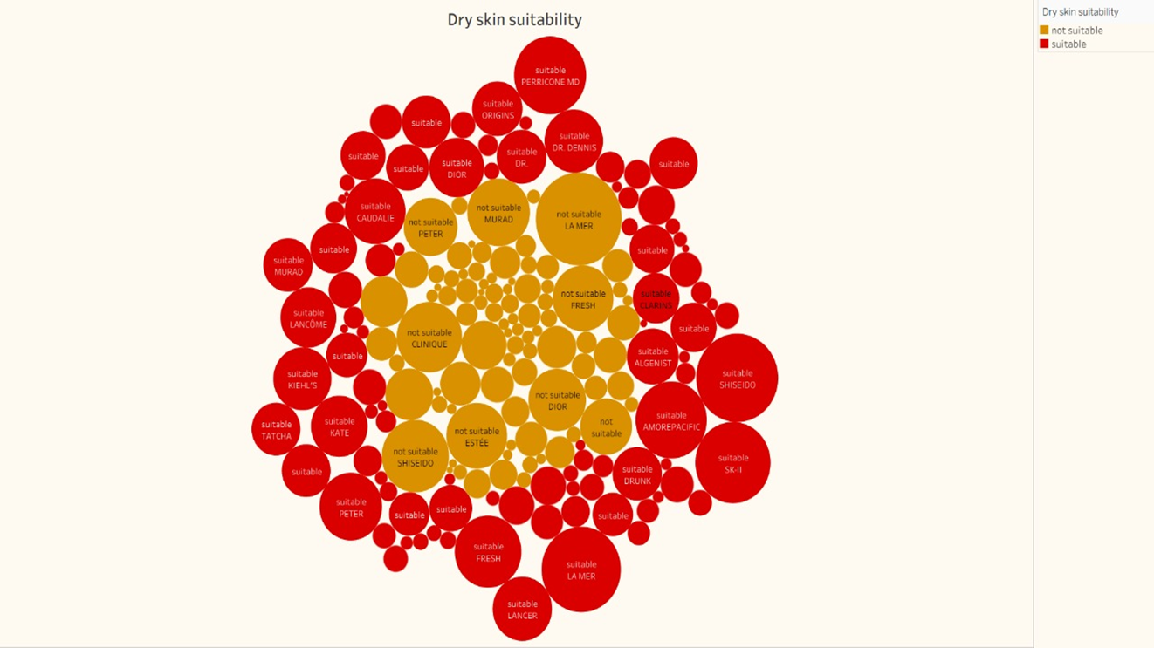
Dry Skin Suitability
What it shows: A bubble chart indicating the number of suitable and not suitable products for dry skin — bubble size representing product count.
Insights:
Some brands have a higher number of suitable products.
Visualizes product spread quickly using bubble size.
Why it matters: Helps dry skin users find brand options and gives an overview of how brands support this category.

Slide 12
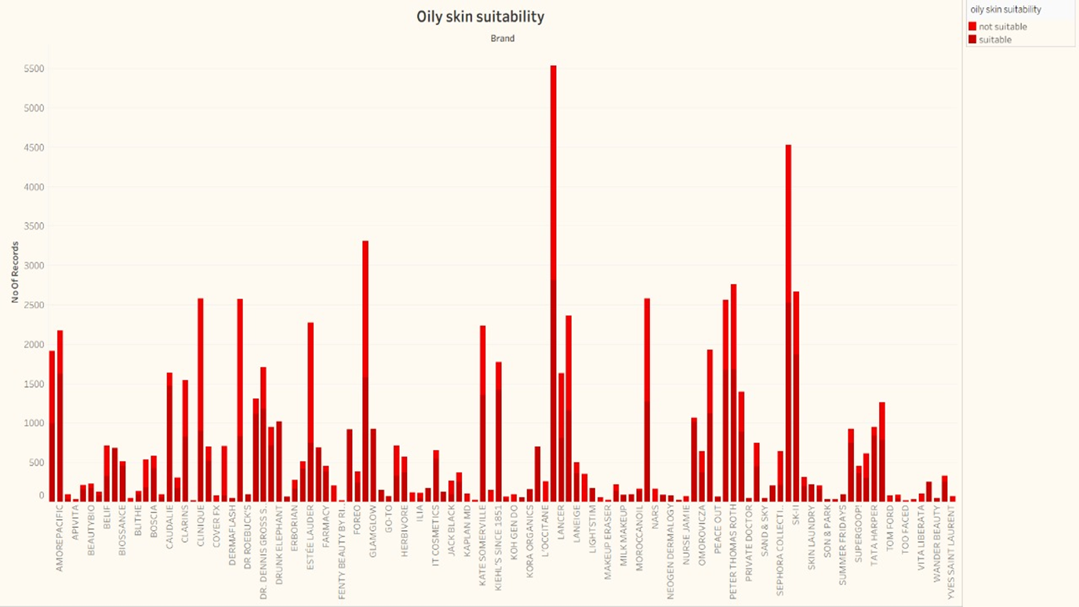
Oily Skin Suitability
What it shows: A bar chart displaying how many products from each brand are suitable for oily skin.
Insights:
Multiple brands offer suitable options for oily skin.
Notably high suitability from brands like Clinique and Fenty Beauty.
Why it matters: Oily skin is a common concern — this chart helps identify which brands cater to it effectively.

Slide 13
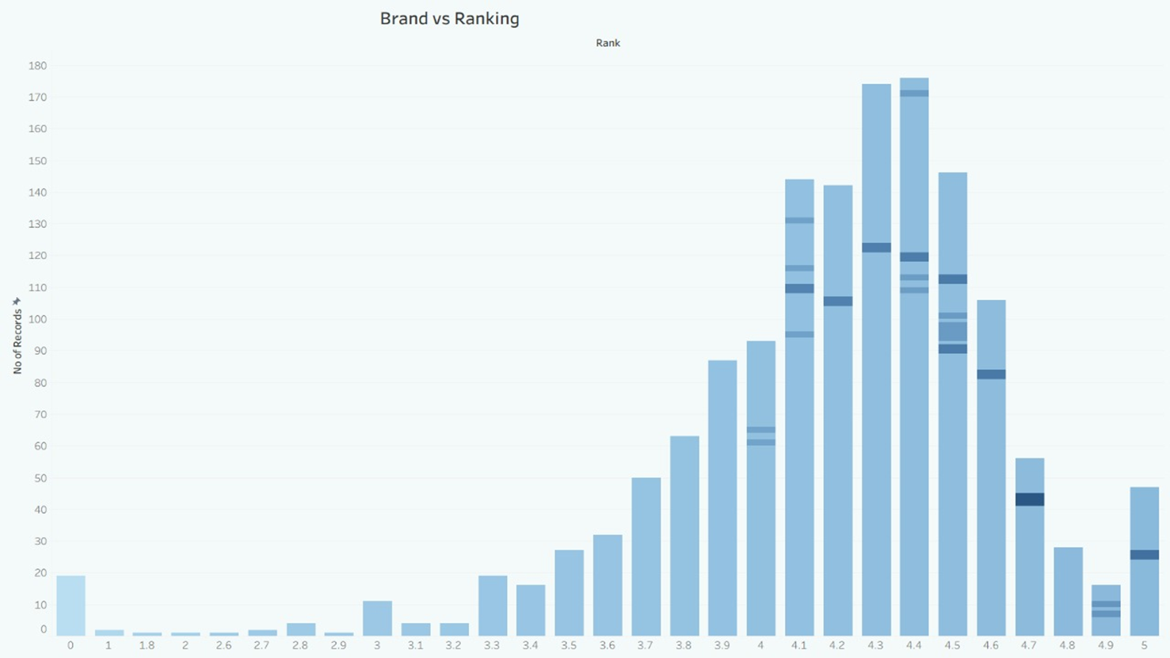
Brand VS Ranking
What it shows: A bar chart showing the number of products across different ranking levels (e.g., 3 to 5 stars).
Insights:
Most products have rankings between 3.5 to 4.5, indicating positive feedback.
Very few products fall below 3.
Why it matters: Reflects overall consumer satisfaction and helps brands monitor their product performance.

Slide 14
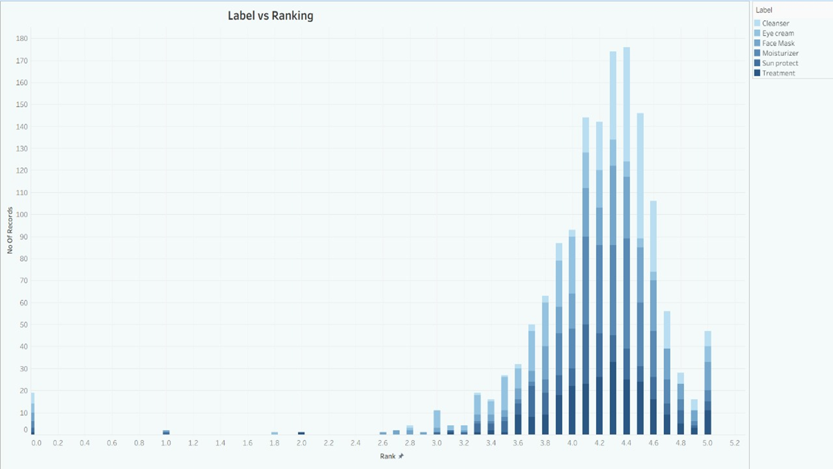
Label VS Ranking
What it shows: A stacked bar chart displaying the number of products under each product label (Moisturizer, Cleanser, Face Mask, Treatment, Eye Cream, Sun Protect) distributed across different ranking values.
Insights:
Most products are rated between 3.8 to 4.5 stars.
Labels like Moisturizer, Face Mask, and Treatment have a higher count of products in the 4.0 to 4.5 range.
Very few products are rated below 3.0, indicating good overall customer satisfaction.
Why it matters: Helps to identify which product labels perform better in terms of customer reviews and highlights the overall positive quality trend in the market.

Slide 15
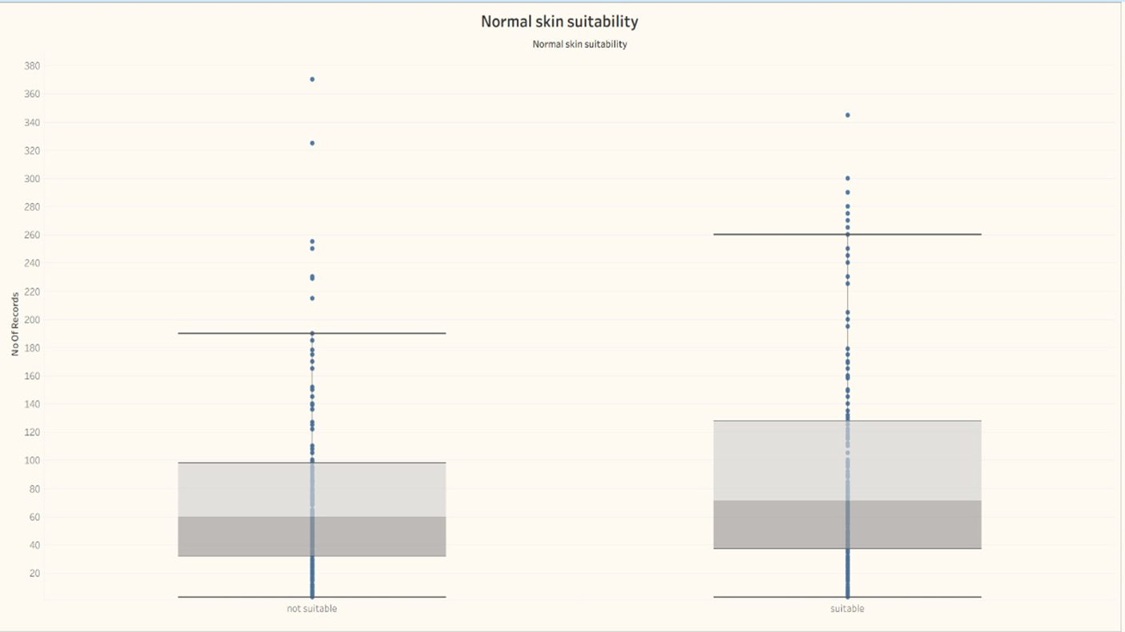
Normal skin Suitability
What it shows: A box plot dividing products as suitable or not suitable for normal skin.
Insights:
Products are fairly balanced between suitable and not suitable categories.
Most fall within a consistent suitability range.
Why it matters: Shows product suitability trends for normal skin users and product reliability.

Slide 16
Conclusion:
After analyzing the cosmetics product dataset through interactive Tableau dashboards, several valuable insights were identified:
Clinique, Murad, and Sephora Collection emerged as the top brands with the highest number of products.
Moisturizer and Cleanser were the most frequently available product labels, indicating high consumer demand for these categories.
The majority of cosmetic products are priced under ₹2000, though some luxury brands offer products above ₹5000.
Most products received customer rankings between 3.8 and 4.5, reflecting overall positive consumer feedback in the cosmetics market.
In terms of skin suitability, certain brands consistently offered products suitable for sensitive, oily, dry, and normal skin types, with Clinique and Sephora Collection leading in sensitive skin options.
The Label vs Ranking analysis showed that product labels like Moisturizer, Face Mask, and Treatment consistently achieved higher customer satisfaction.
📌 Overall Outcome:
This analysis provides a clear understanding of market trends, brand performance, pricing strategies, and product suitability in the cosmetics industry. It can help both consumers in choosing suitable products and brands in optimizing their offerings to meet market demands.

Slide 17
Thank you

